Slide 1

Student class registration program
By Lyle Pixton
CST499 Capstone
Dr. Amr Elchouemi
3/29/21

Slide 2

UML design models
The following slides show the different design models that were used in this project starting with the Waterfall model which shoes the process used for building a software from start to finish in a simple, easy to read format.
Next is the Spiral model which shows the different four different phases of the project development and shows the tasks that happen in each one along the line of progress.
Next is the different levels of testing that occur and the tasks withing those different levels.
Next is the basic workflow of the software and its different screens and how they should connect.

Slide 3
Plan
Waterfall model
Requirements
Design
Implementation
Test
Maintenance

Slide 4
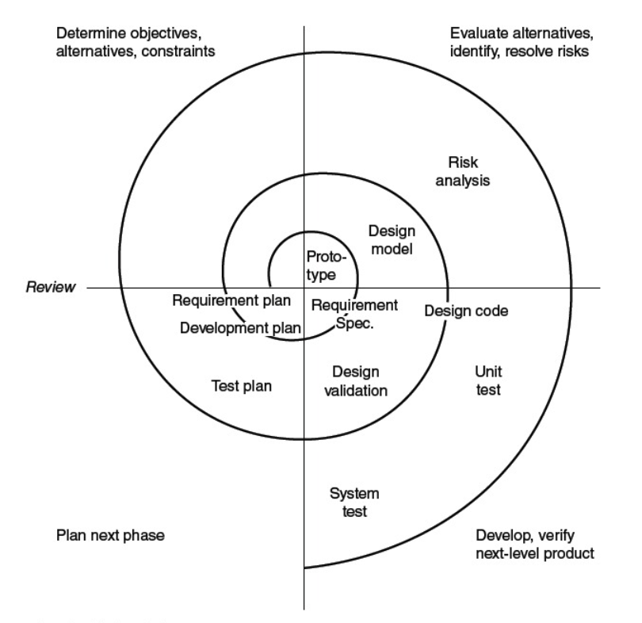
Spiral model

Slide 5
Level 1 - Unit testing
Testing individual functions separate from the system as a whole
Level 2 - Functional testing
Testing the unit in relation to other units
Use path analysis techniques
Use boundary value analysis techniques
Use equivalence-class partitioning
Use combinations of conditions
Level 3 - Integration and system testing
Testing the unit as part of the system as a whole
Repeat testing done in prior levels
Create automated and test-driven tests for the system
Create coverage data and additional tests until risk is low
Often called QA or regression testing
End Testing

Slide 6
Log in page
Registration page
Remove Class
Log in functionality
Home Page
Class Registration page
Current Class
Registration
Functionality
Log out
Add Class

Slide 7
Software Design
Login page
This is the first page you see and is the page that you’re directed to if you try to go to any other page without having first logged in. It asks for your email address and password then has a login button underneath. If you are not already in the database, there is a link to sign up underneath the log in fields that has the options to sign up. After signing up or logging in, it takes you directly to the landing page.
Landing page
This page is simple. It just shows the user email, name, student ID and then gives links to the class enrollment page, and the option to log out.
Enrollment page
The most complicated page which has a section that shows the currently registered classes for the user that is logged in. Below, it has a list of all the available classes that exist in the database with the detail about them such as the class ID, name, and time along with an add and remove button.

Slide 8
MySQL database setup
For this project, I only needed three distinct tables held withing the database “studentregister” and the rest of the information was produced from the data within these three tables. For future growth, more could be added but this was all that was needed at the moment.
The table “students” was first so we could get users logged in. This table has the fields studID, studFirstName, studLastName, studEmail, studPassword. All fields are pulled from what the student enteres through the webpage.

Slide 9
MySQL database setup (continued)
Next table was “classes” that can only be updated by the admin by entering the needed information into the database directly. The fields for this table include classid, className, classTime, and classFull.
Next is the table called “regclasses” which holds the classes that have been selected for registration. This holds fields regID, regStudID, regClassID. The regStudID and the regClassID are both taken from the unique identifiers from the other two tables while the regID is the unique identifier for this table. All unique identifiers are autoincremented so there’s no need for those to be manually input from any code.

Slide 10
PHP code description
It starts with the page called server which establishes the session, checks the password and username/email with what is in the database and returns an error if what is entered doesn’t exist in the database. This also holds the code for checking if the registration information. Once the user is logged in, they are pushed to the home page.
The registration page takes the info entered in from the user and records them as variables which are then pushed to the database and pushes the user to the home page.
The Homepage page takes the users info that is in the database and displays it then gives the option of logging out or going to the class registration page.

Slide 11
PHP code description (continued)
The classregisterpage is the most complicated because includes the listofclasses page of code. It takes the session email address and refers it to the student table and then get the student ID from that list so it can add it to the regclasses table when the add or remove function is taken. The classes are listed in a table that loops for all classes added so when classes are added or removed from the table, the table doesn’t need to be adjusted to fit the number of classes. Above this table of classes is the currently enrolled classes which uses an SQL on the regclasses table that looks for any class that exists in this table that has a student ID that matches the one connected to the current session. The greatest difficulty came from getting a variable to hold the class ID from what ever add or remove was selected.
All pages of code refer to the style.css for it’s formatting reference.

Slide 12
Testing
“In order to supports a company with best excellent software applications then we need to make sure the quality of software application in term of easy to maintenance, understandability, reusability and so on” (Sarwo, 2017).
We will use the waterfall approach for this as the process is very straight forward and the program is not large enough to require anything more extreme. We expect the Waterfall model to provide enough guidance to resolve any issues that come up in the testing environment. This methodology also coincides with our agile development process well and is a familiar approach.
Test Plan
Test Cases
Requirement Traceability Matrix
Bug Reports
Test Strategy
Test Metrics
Customer Sign Off
Incident reporting strategy
Management strategies for configuration

Slide 13
References
Tsui, F., Karam, O., & Bernal, B. (2018). Essentials of software engineering (4th ed.). Jones & Bartlett Learning
Mon, C. T., Hlaing, S. S., Tin, M. M., Khin, M. M., Lwin, T. M. M., & Myo, K. M. (2019). Code Readability Metric for PHP. 2019 IEEE 8th Global Conference on Consumer Electronics (GCCE), Consumer Electronics (GCCE), 2019 IEEE 8th Global Conference On, 929–930. https://doi-org.proxy-library.ashford.edu/10.1109/GCCE46687.2019.9015229
Sarwo, Warnars, H. L. H. S., Gaol, F. L., & Randriatoamanana, R. (2017). Object oriented metrics to measure the quality of software upon PHP source code with PHP_depend study case request online system application. 2017 International Conference on Applied Computer and Communication Technologies (ComCom), Applied Computer and Communication Technologies (ComCom), 2017 International Conference On, 1–5. https://doi-org.proxy-library.ashford.edu/10.1109/COMCOM.2017.8167097

